Slide 1

Electronic Follow UP Project
1

Slide 2


Introduction :
An interface that provides some services to track the status of the vehicle electronically, by following the systematic method to facilitate access to the status of the vehicle, and this is done by placing a chip in the vehicle's pigtail to read its status and send it to the service providers and then send it to the application to obtain information about the status of the vehicle.
2

Slide 3


Graphical user interface :
A digital interface that allows users to interact with graphical elements like buttons, menus, and icons .
3

Slide 4

Why was the choice made to Graphical user interface ?
Because, the goal is to design a mobile application interface, and through that, the choice fell on the graphical user interface, because it maybe the most user-friendly interface; it provides interactive methods that facilitate the access process.
4

Slide 5
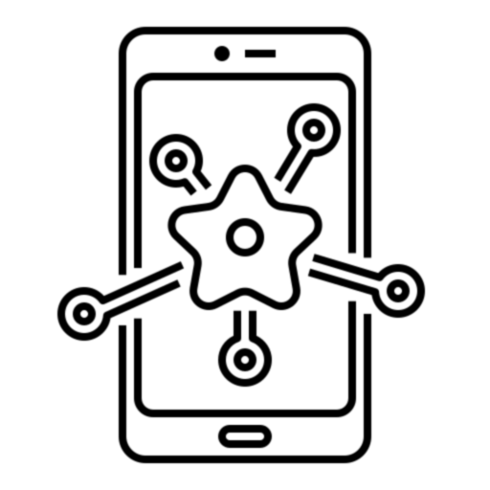
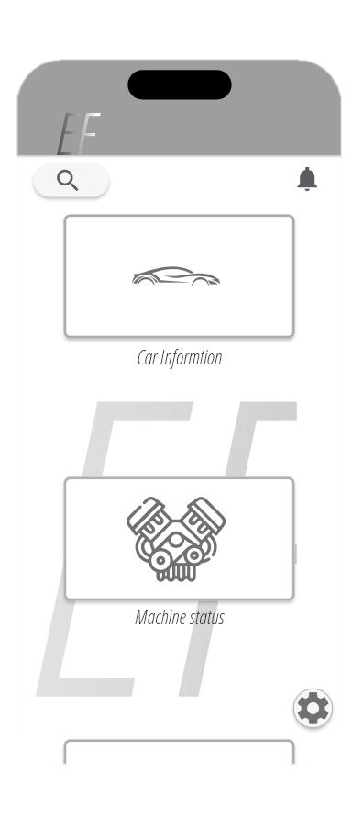
features :
Dashboard: A centralized dashboard providing an overview of all follow-up tasks, including status updates and deadlines. It should offer quick access to various sections of the application.
As shown in the interface : It contains a menu, interactive buttons, and simulated reality icons for easy access.
5

Slide 6

features :
Notifications : to alert users about updates to the application or to update its information to ensure quality of service, and notification settings will be customizable .
6

Slide 7

features :
Search and Filter : To allow users to search for Their Preference or filtering it, this enhances efficiency in finding and managing tasks.
7

Slide 8

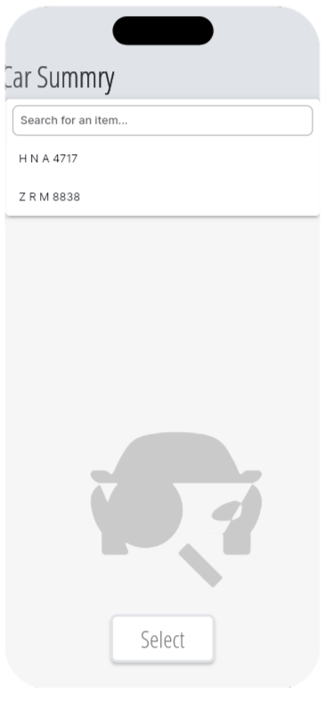
features :
User Roles and Permissions : Control access to documents, to ensure that only authorized users can view them. This adds a layer of security and confidentiality to the system.
8

Slide 9

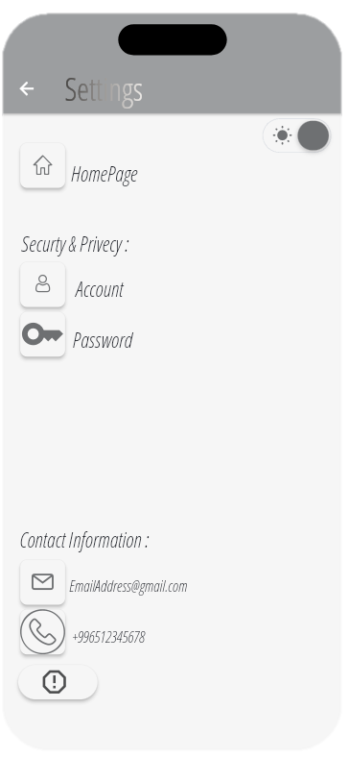
features :
Reporting : features are included to create custom reports on task progress, completion rates, and other relevant metrics. This helps stakeholders track project performance and identify areas for improvement.
9

Slide 10
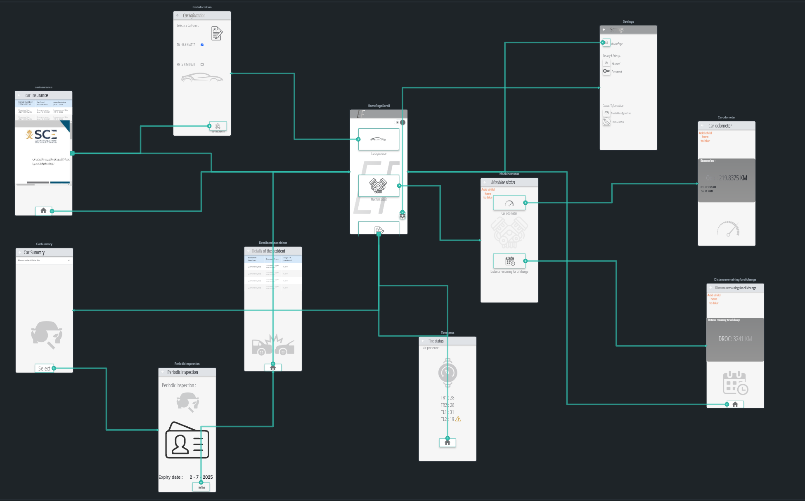
Prototype Layout:
10

Slide 11

Thanks :
Do you have any questions?
Mohammed Tariq Al-Sirhani
11

